Slide 1
KeyStone SoC Training SRIO Demo: Board-to-Board
Multicore Application Team

Slide 2
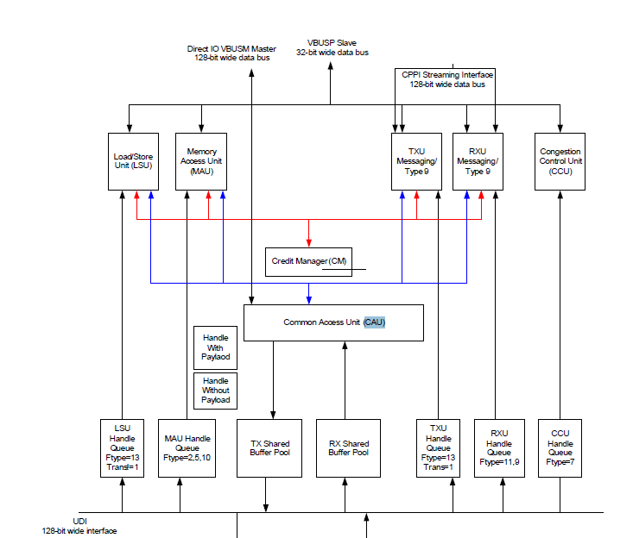
SRIO High Level Block Diagram

Slide 3
Agenda
Model
Protocol
Configuration
Application Algorithm
Build and Run

Slide 4
The Model
Requirements:
Efficiency – Not fairness
Minimize master logic
Master is not aware of structure of internal cores
Producer = Master
Consumer = Slave

Slide 5
Agenda
Model
Protocol
Configuration
Application Algorithm
Build and Run

Slide 6
Producer (Master) Protocol
Producer = Master
Consumer = Slave

Slide 7
Consumer (Slave) Protocol
Producer = Master
Consumer = Slave

Slide 8
Agenda
Model
Protocol
Configuration
Application Algorithm
Build and Run

Slide 9
Hardware Components

Slide 10
Packet DMA Topology
FFTC (B)
Queue Manager Subsystem
FFTC (A)
SRIO
Queue Manager
PKTDMA
0
1
PKTDMA
PKTDMA
2
3
4
5
.
.
.
8192
AIF
PKTDMA
Network
Coprocessor
PKTDMA
PKTDMA
Multiple Packet DMA instances in KeyStone devices:
PA and SRIO instances for all KeyStone devices.
AIF2 and FFTC (A and B) instances are only in KeyStone devices for wireless applications.
Notes:
NEW

Slide 11
Navigator Configuration
Link Ram - Up to two LINK-RAM
One internal, Region 0, address 0x0008 0000, size up to 16K
One External, global memory, size up to 512K
Memory Regions - Where descriptors actually reside
Up to 20 regions, 16 byte alignment
Descriptor size is multiple of 16 bytes, minimum 32
Descriptor count (per region) is power of 2, minimum 32
Configuration – base address, start index in the LINK RAM, size and number of descriptors
Loading PDSP firmware

Slide 12
Navigator Configuration
Descriptors
Create and initialize.
Allocate data buffers and associate them with descriptors.
Queues
Open transmit, receive, free, and error queues.
Define receive flows.
Configure transmit and receive queues.
PKTDMA
Configure all PKTDMA in the system.
Special configuration information used for PKTDMA.

Slide 13
Configuration/Initialization Flow
Configuration Steps:
QMSS
Generic PKTDMA
QMSS PKTDMA
SRIO
SRIO PKTDMA
Sockets

Slide 14
QMSS Initialization
Qmss_init (qmss_drv.c)
Number and location of the link RAM
Number of descriptors
APDSP firmware
Set global structure qmssLobj to be used later
Qmss_start (qmss_drv.c)
Load global structure into local memory of each core
Qmss_insertMemoryRegion (qmss_drv.c)
Base address of each region
Number of descriptors
Size of descriptors
Region type
How the region is managed (either by the LLD or the application)
Region number (or not specified)

Slide 15
Global PKTDMA (CPPI) Initialization
cppi_init (cppi_drv.c) loads all instances of PKTDMA from the global structure cppiGblCfgParas, which is defined in the file cppi_device.c
SRIO
PA
QMSS
AIF (wireless applications only)
FFTC (wireless applications only)
BCP (wireless applications only)
SRIO PKTDMA (CPPI) configuration after SRIO configuration

Slide 16
SRIO Initialization
enable_srio
Power
PLL/Clock
srioDevice_init
Handle for the SRIO instance
SERDES
Port
Routing and queues

Slide 17
SRIO PKTDMA (CPPI) Initialization
Configure SRIO PKTDMA
Set the Rx routing table to the following default locations:
Type 11
Type 9
Direct IO

Slide 18
Application-specific Configuration “All Cores” Initialization
Create and initialize descriptors.
Allocate data buffers.
Associate a receive queue with each core.
Define receive free queue.
Define receive flows.
Define and configure transmit queues.
Enable transmit and receive channels.
Connect SRIO interrupts.

Slide 19
Open Sockets
Srio_sockOpen() opens a socket
Srio_sockBind() binds the opened socket to routing
Segmentation mapping

Slide 20
Agenda
Model
Protocol
Configuration
Application Algorithm
Build and Run

Slide 21
Producer (Master) Application Algorithm
Producer = Master
Consumer = Slave

Slide 22
Consumer (Slave) Application Algorithm
Producer = Master
Consumer = Slave

Slide 23
Code Change: Producer
generateApplicationData(
fftInputBuffer[0], &parameter1) ;
size = 1 << parameter1 ;

Slide 24
Code Change: Consumer
else if (messageValue == TOKEN)
{
applicationCode (
ptr_rxDataPayload, parameter1, coreNum);
}

Slide 25
Agenda
Model
Protocol
Configuration
Application Algorithm
Build and Run

Slide 26
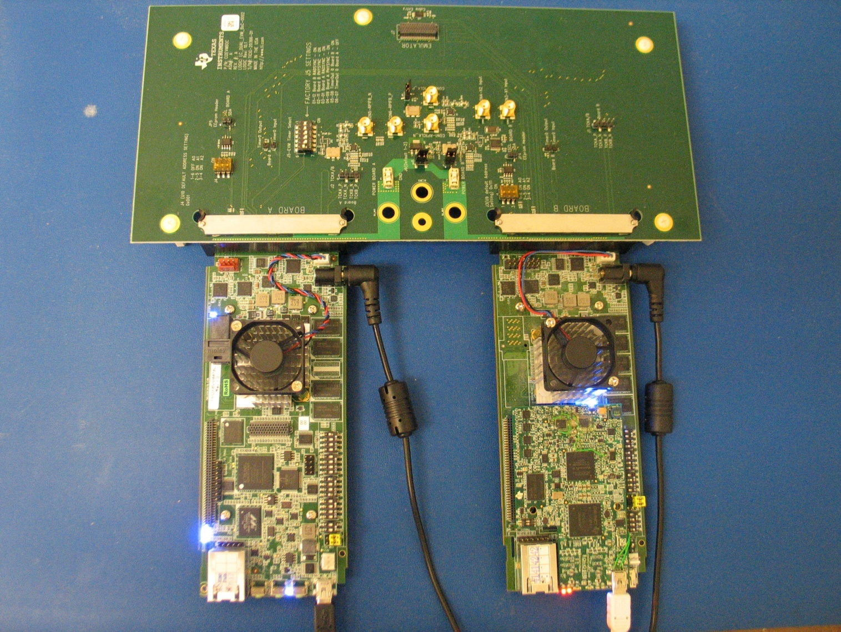
Breakout Connector Board

Slide 27
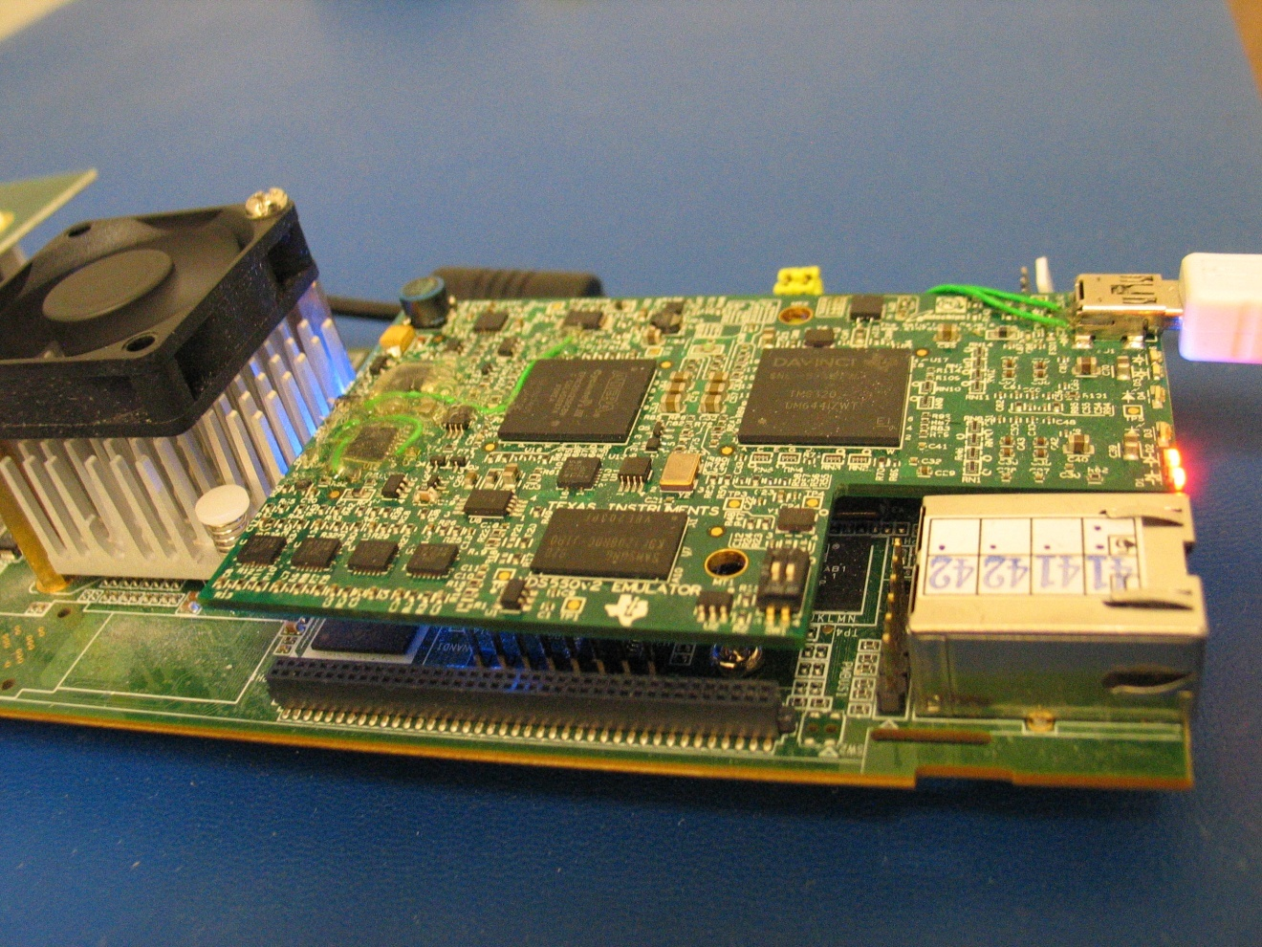
C6678L w/ Mezzanine Emulator

Slide 28
Build and Run Process
Unzip the two projects (producer and consumer).
Update the include path (compiler) and the files search path (linker).
Build both projects.
Connect DSP 0 and load producer to all cores.
Connect DSP 1 and load consumer to all cores.
Run DSP 0 and DSP 1.

Slide 29
Expected Results

